Slide 1
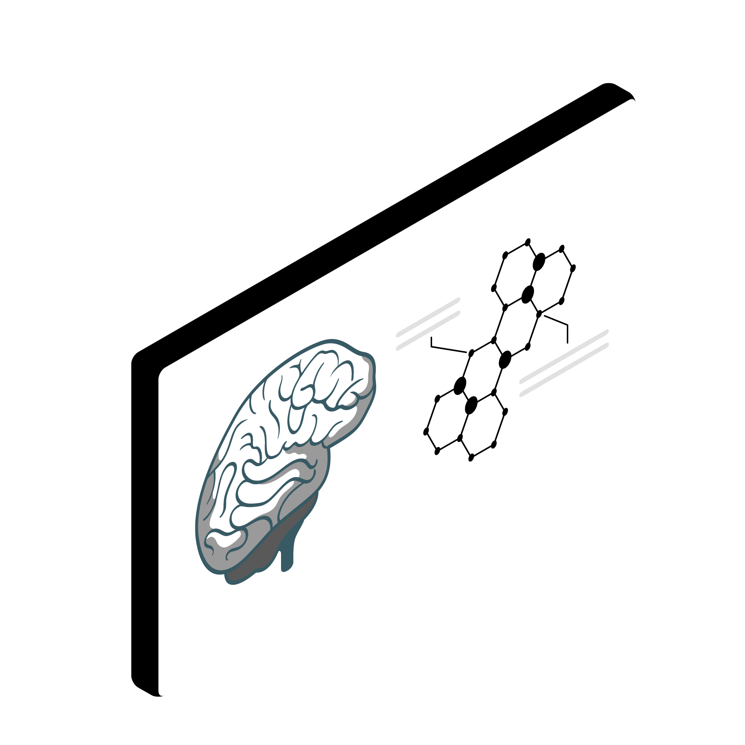


NEURONUTS
(@ pod-Abundant Ipomea)
Investigating multidimensional behavioral influences on brainwide neural activity
TAs: Amirreza Bahramani and Faezeh Shafiei

Slide 2
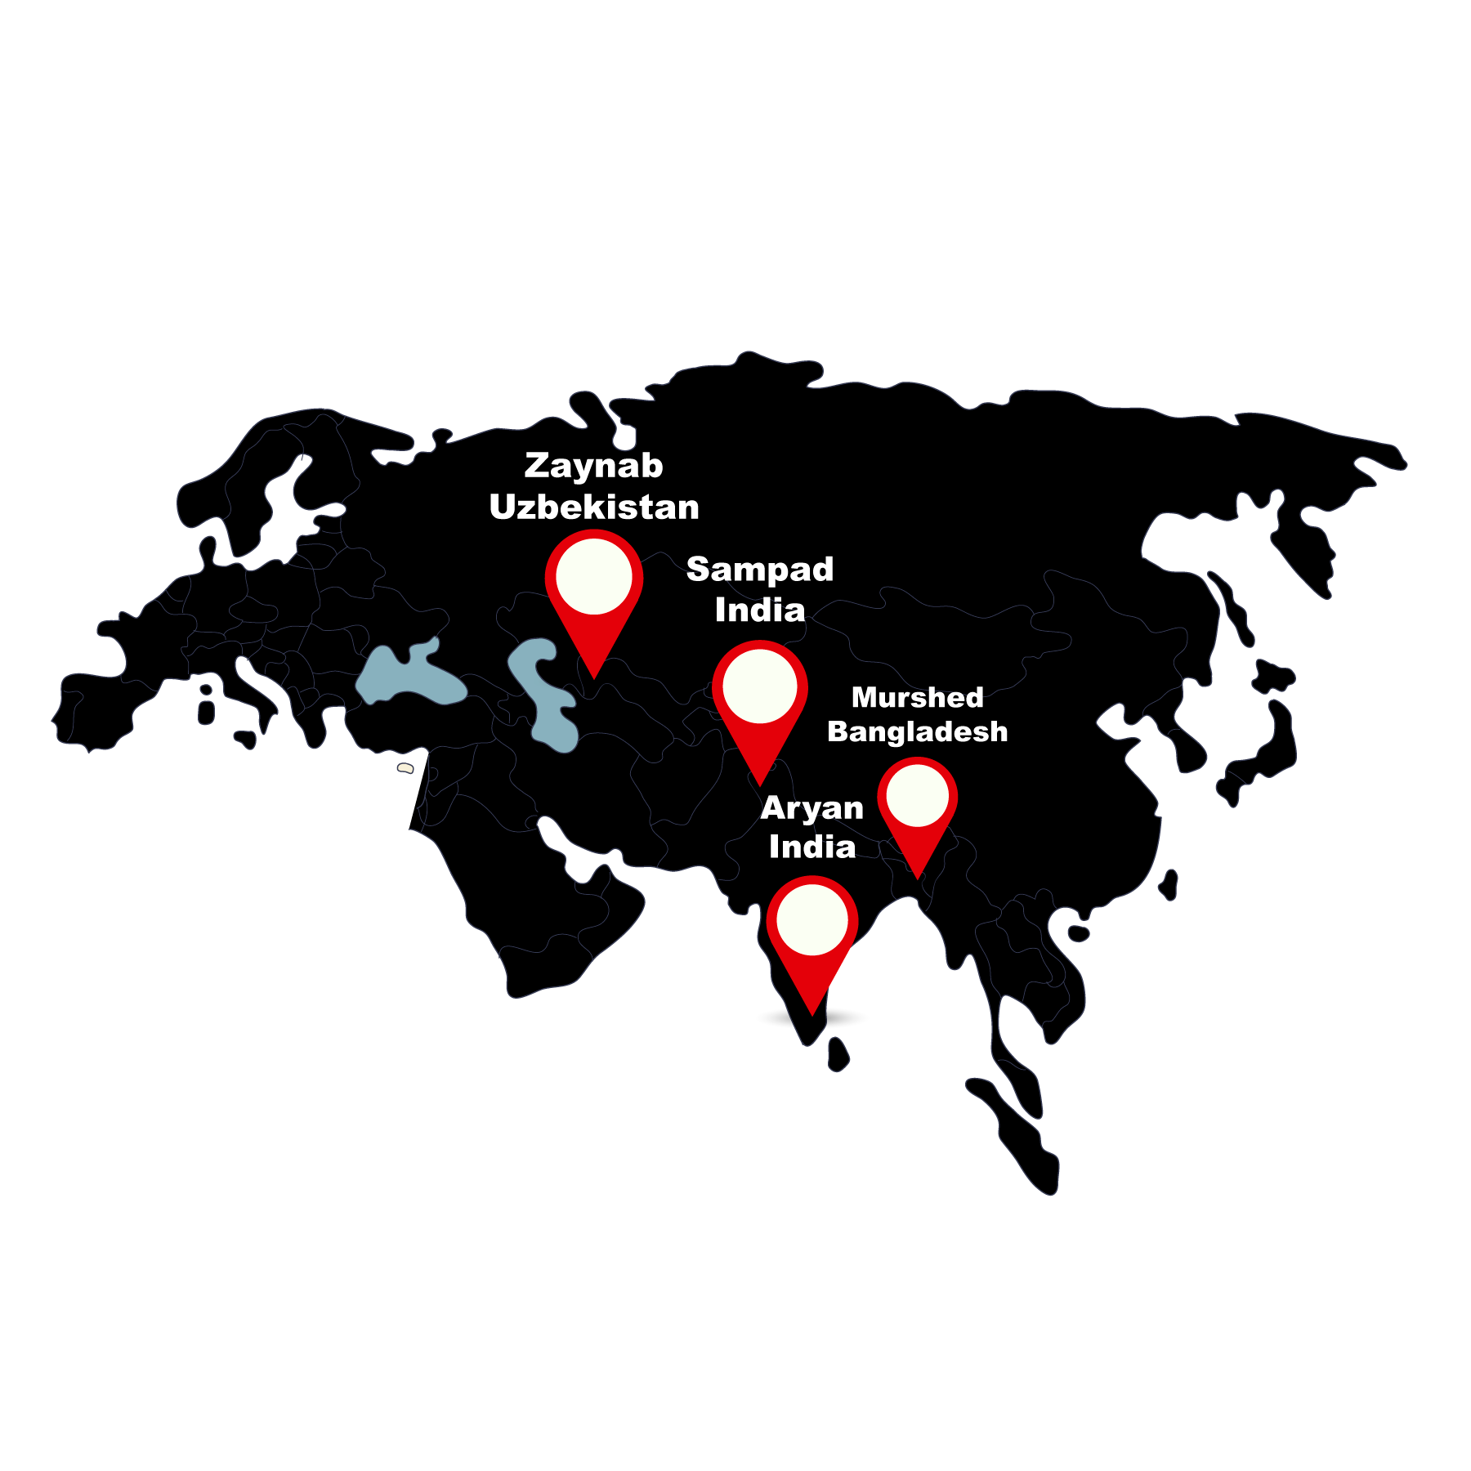

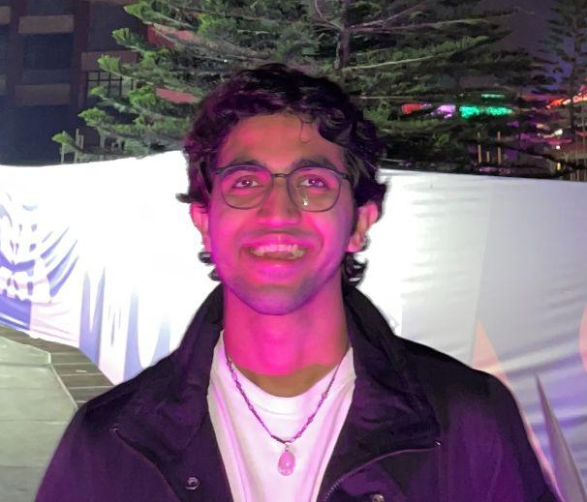


Team Introduction
Murshed Al Amin
Aryan Mohanani
Zaynab Soyokulova
Sampad Debnath

Slide 3
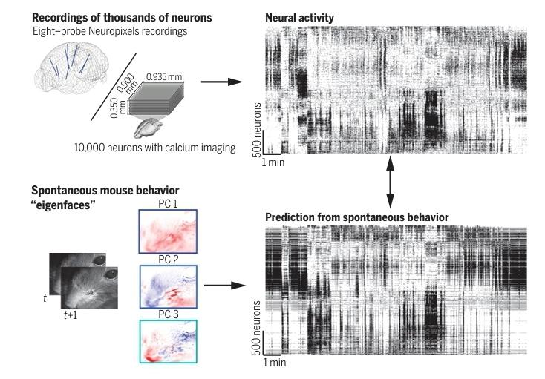
Background
Studies like Stringer et al. (2019) have demonstrated that spontaneous neural activity in the brain is structured and behaviorally driven, rather than random noise.
Ongoing neural activity is linked to multidimensional behaviors, including running, pupil dilation, and others, suggesting a deeper interplay between internal states and brain function.
Primary sensory cortices, previously thought to be solely dedicated to sensory processing, are now understood to integrate sensory inputs with internal behavioral states.

Slide 4
Pivot Story
Initially, we wanted to see how response latencies vary across the visual cortex during visual processing and design a biological plausible neural network based on these latencies.
Turns out, it is not possible to extract the time course of response of a neuron in a single trial in the Stringer Orientation Dataset.
Notes:
I think that we should swap this slide with the next slide, for better continuity

Slide 5
How do spontaneous behaviors such as running and changes in pupil area modulate neural activity within specific cortical depths, and which cortical layers are most significant in encoding these behaviors?

Slide 6
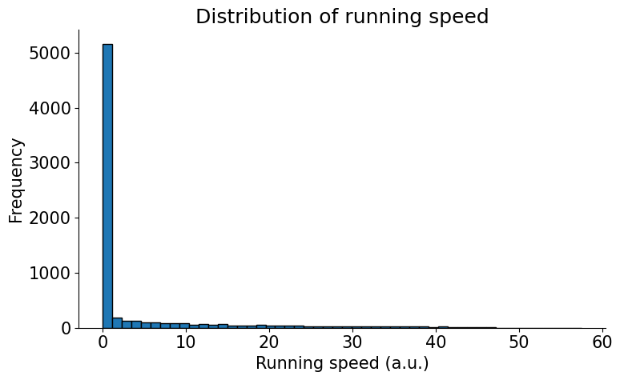
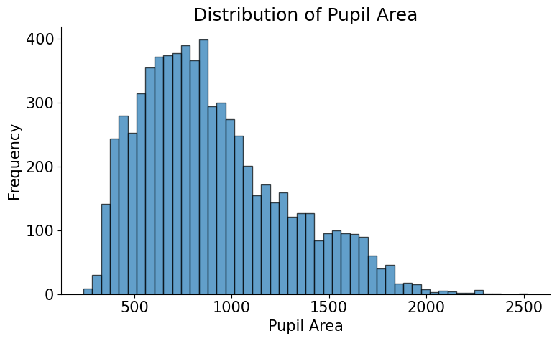
Insights into the Behavioral Data

Slide 7
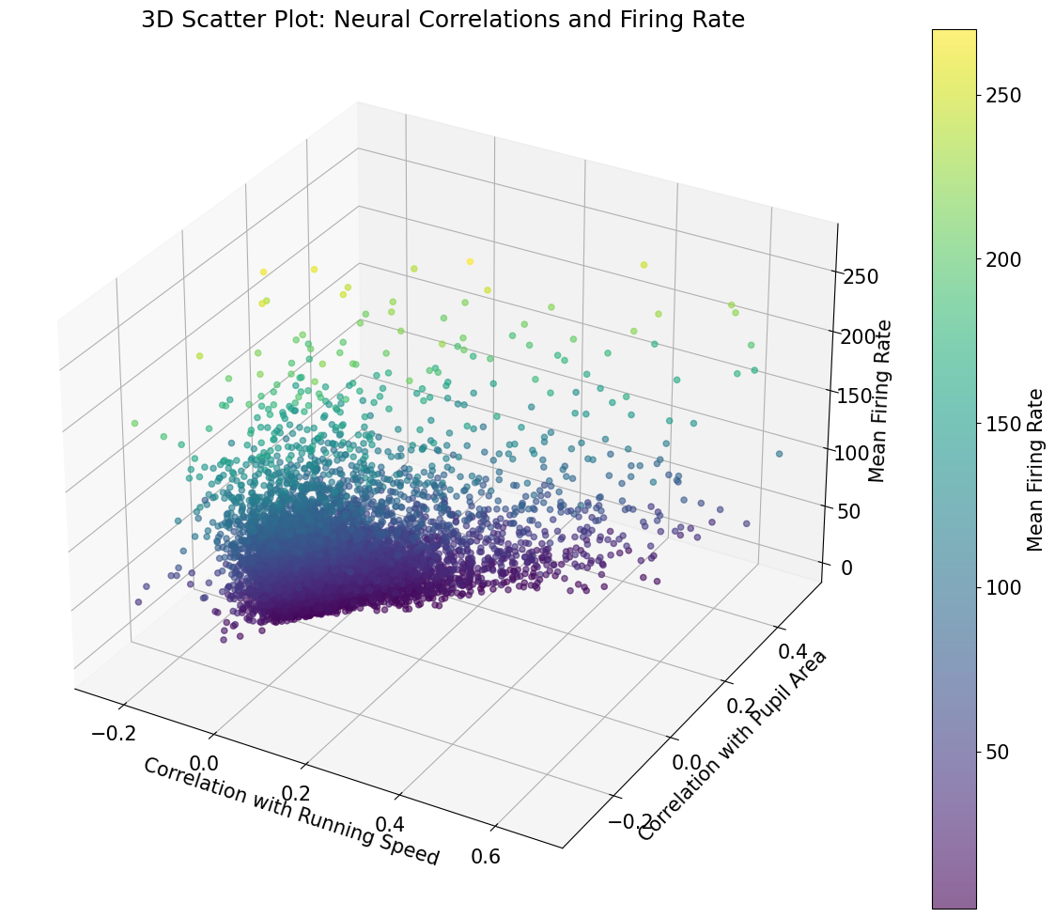
Insights into the Behavioral and Neural Data

Slide 8
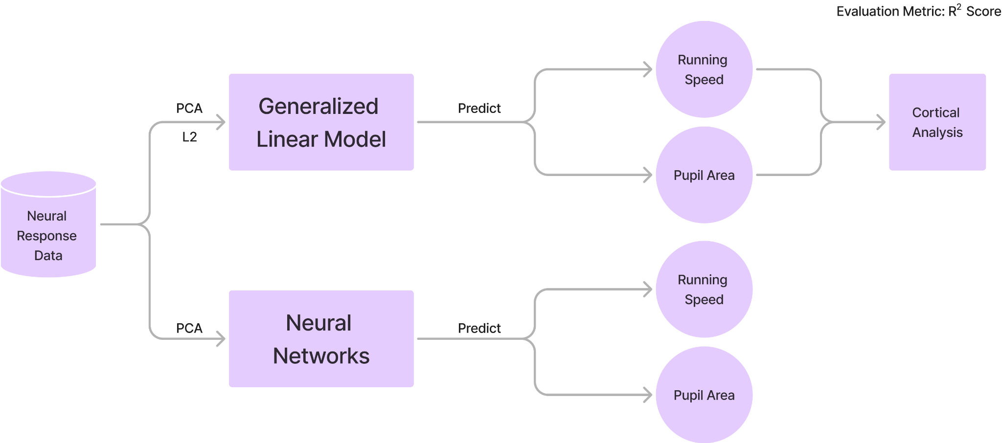
Methodology

Slide 9
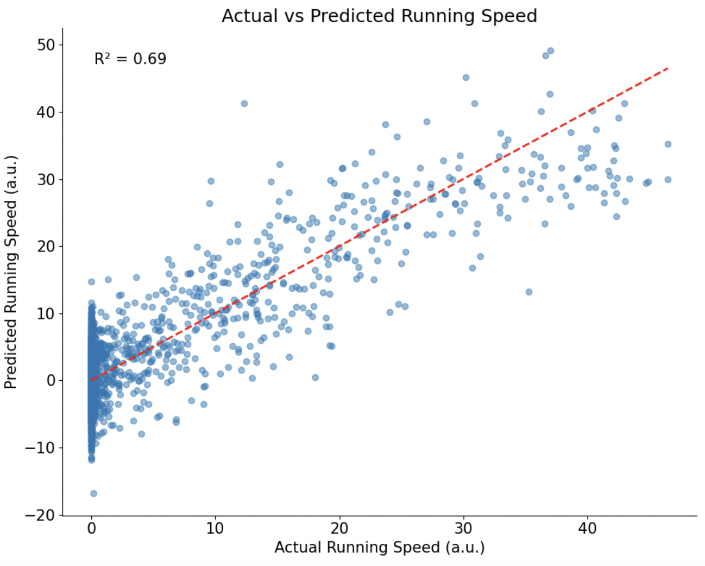
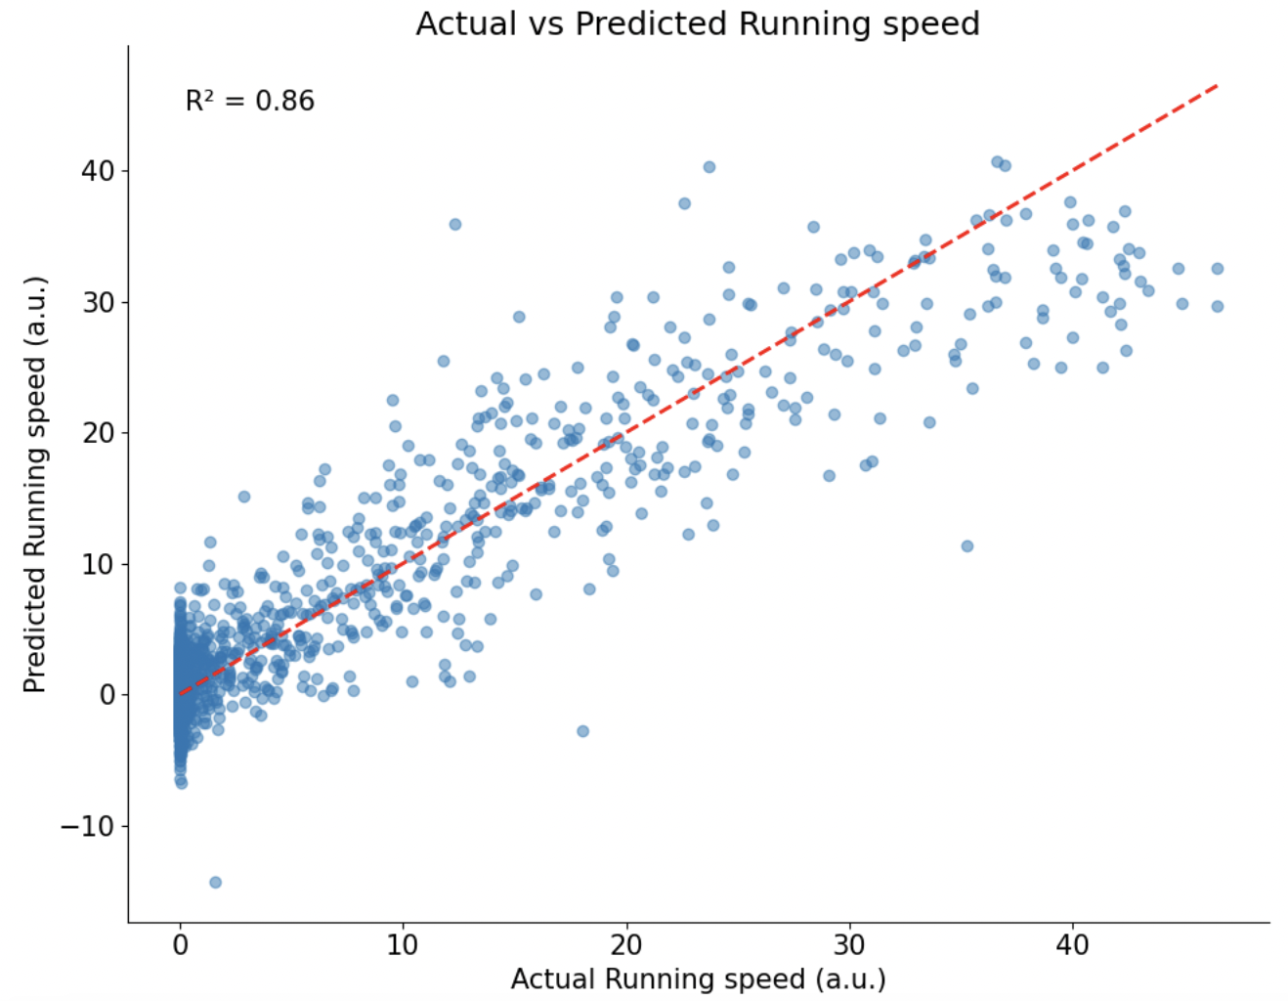
Decoding Running Speed from Neural Activity using GLMs
GLM GLM with PCA

Slide 10
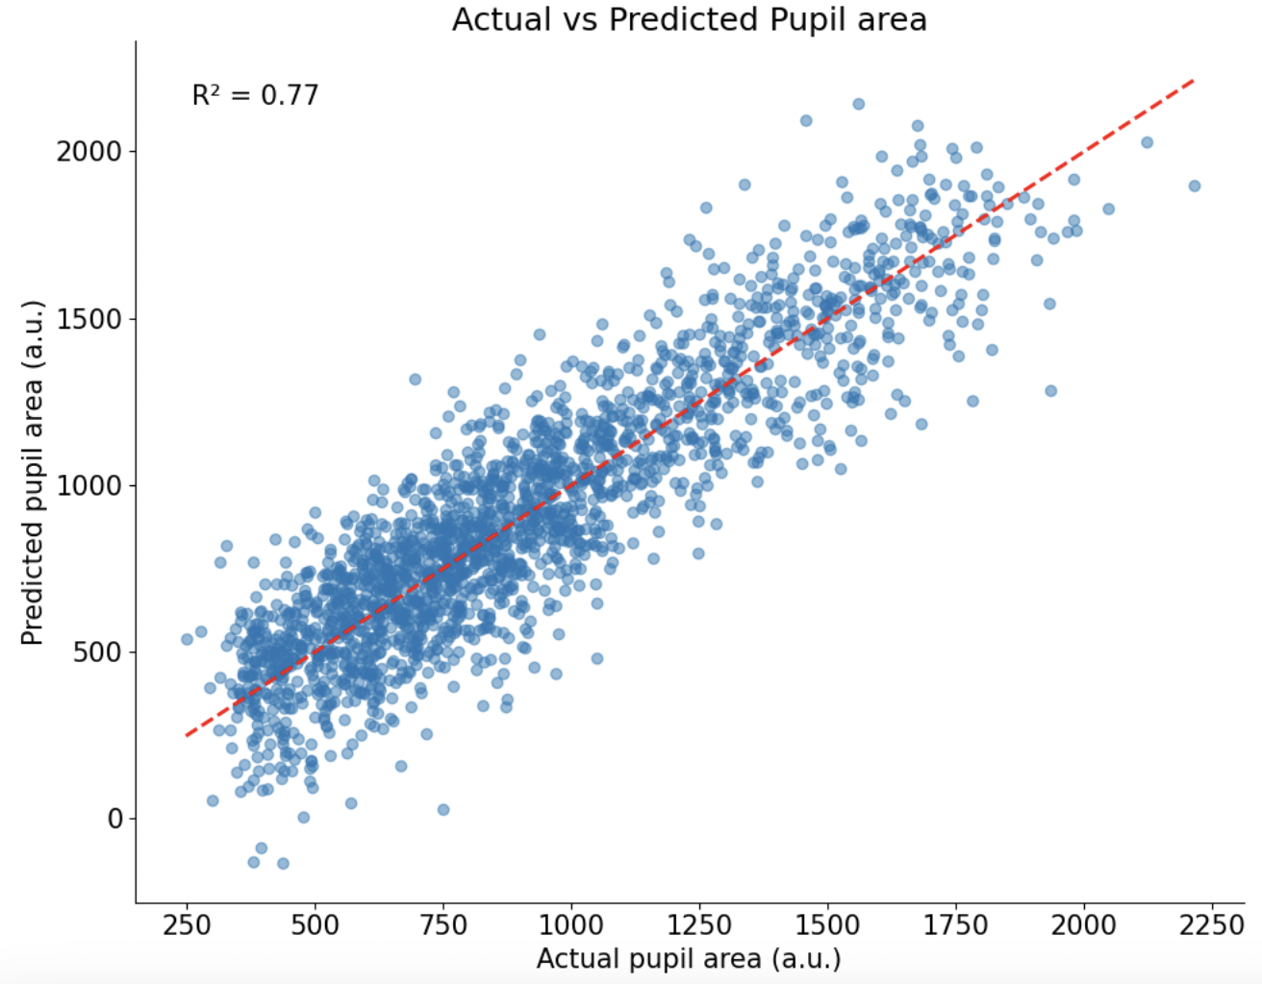
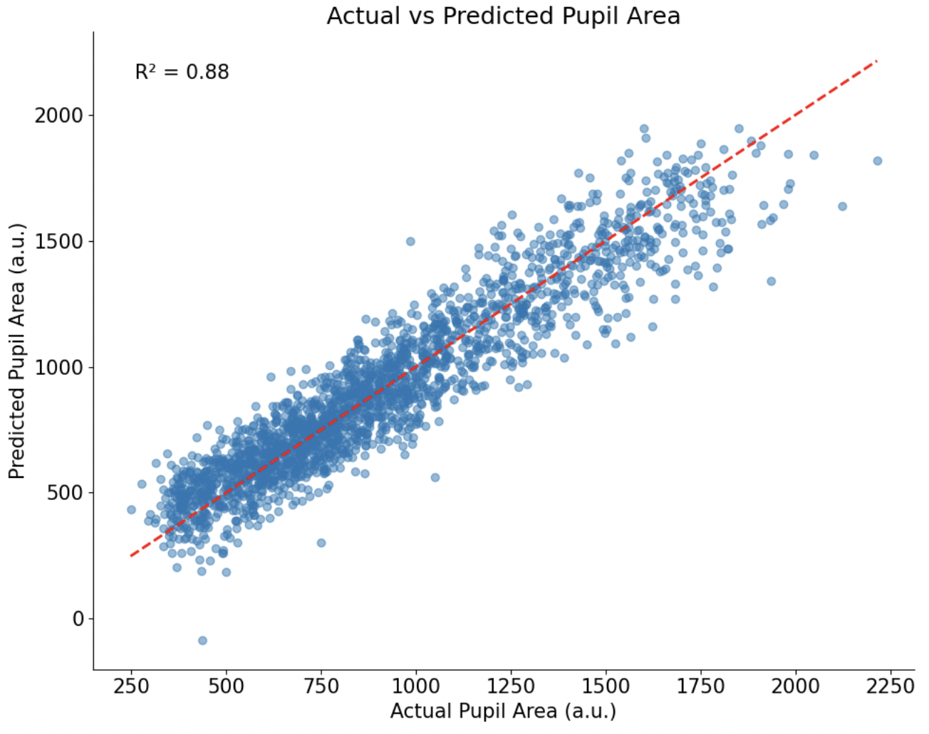
Decoding Pupil Area from Neural Activity using GLMs
GLM GLM with PCA

Slide 11
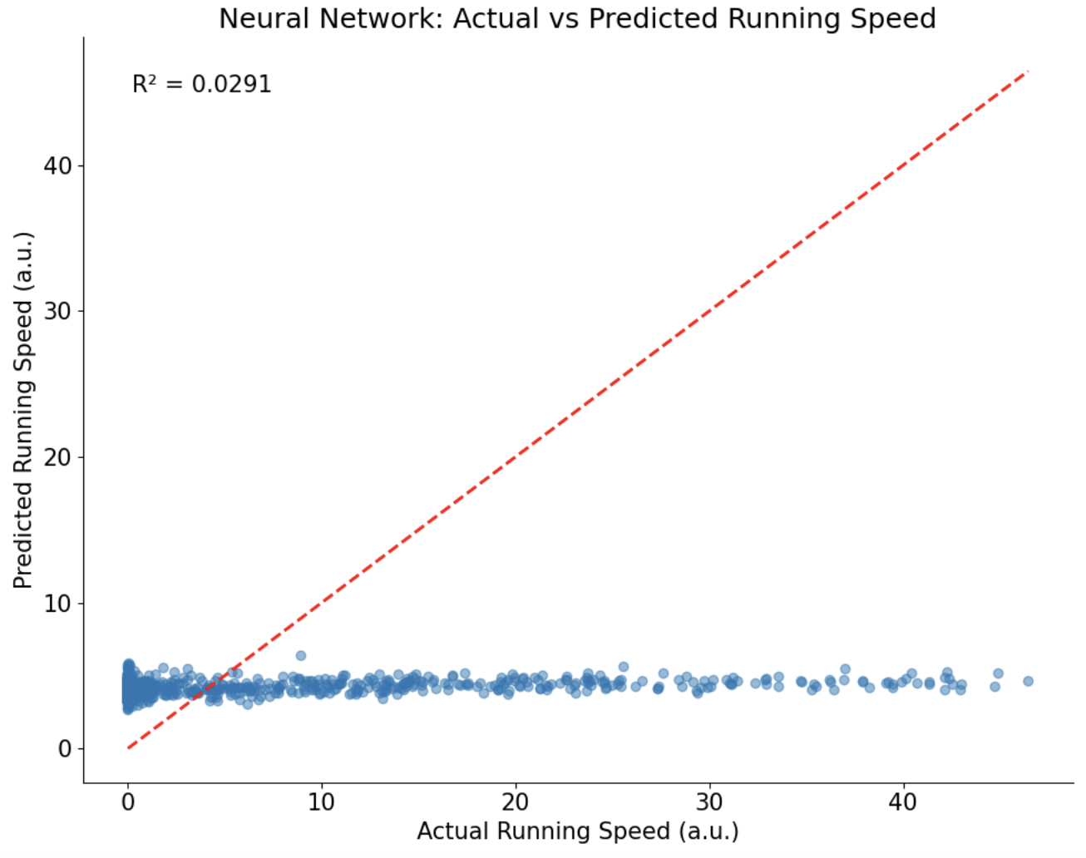
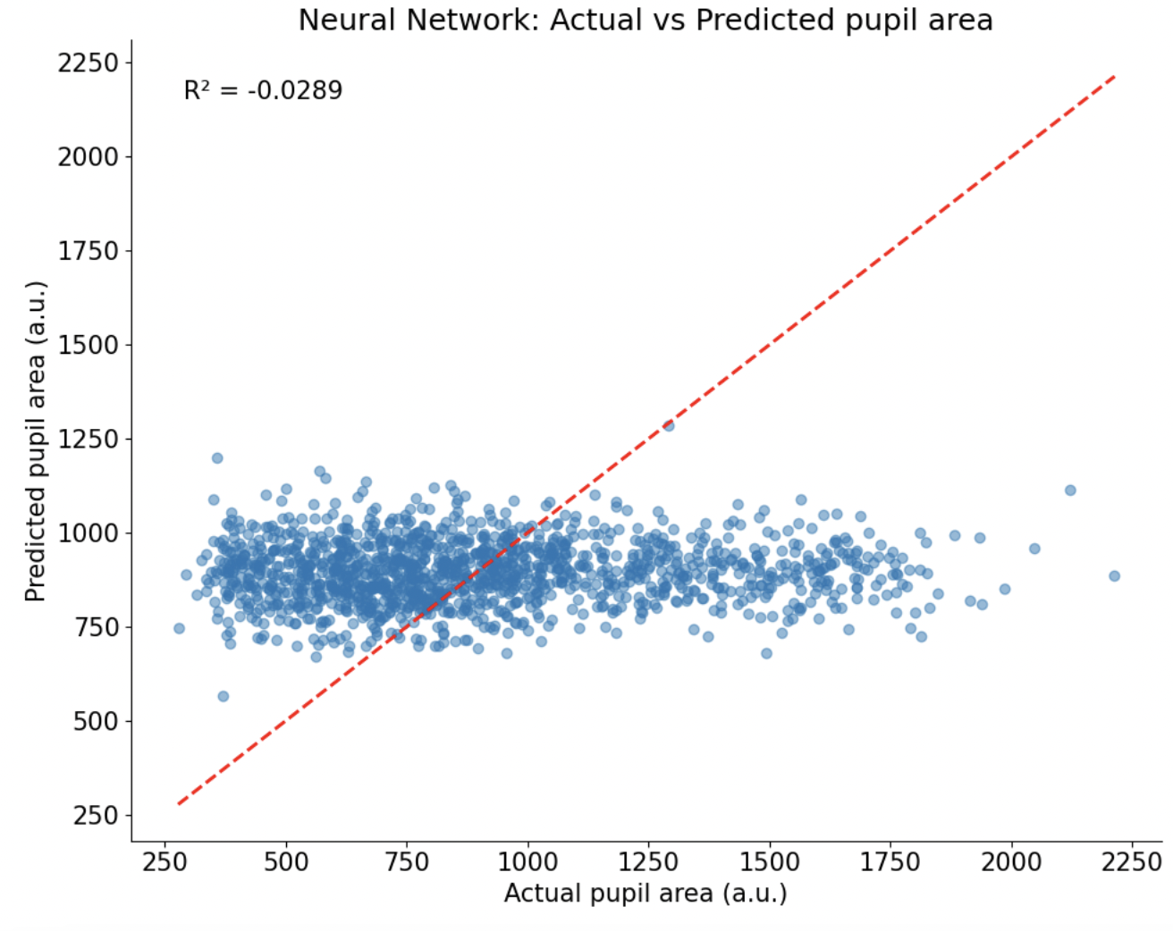
Decoding Running Speed & Pupil Area using Neural Nets
Running Speed Pupil Area

Slide 12
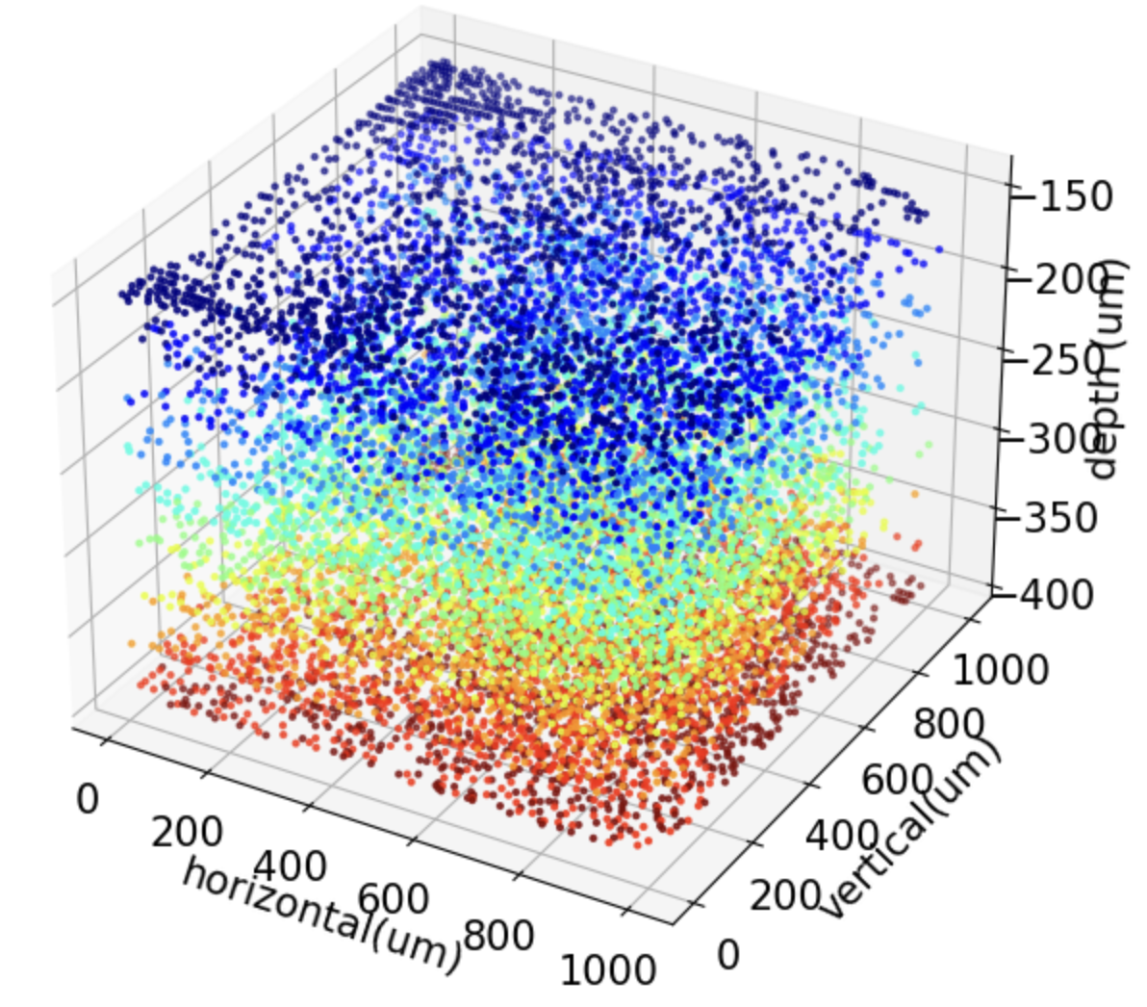
3D visualization
of neurons

Slide 13
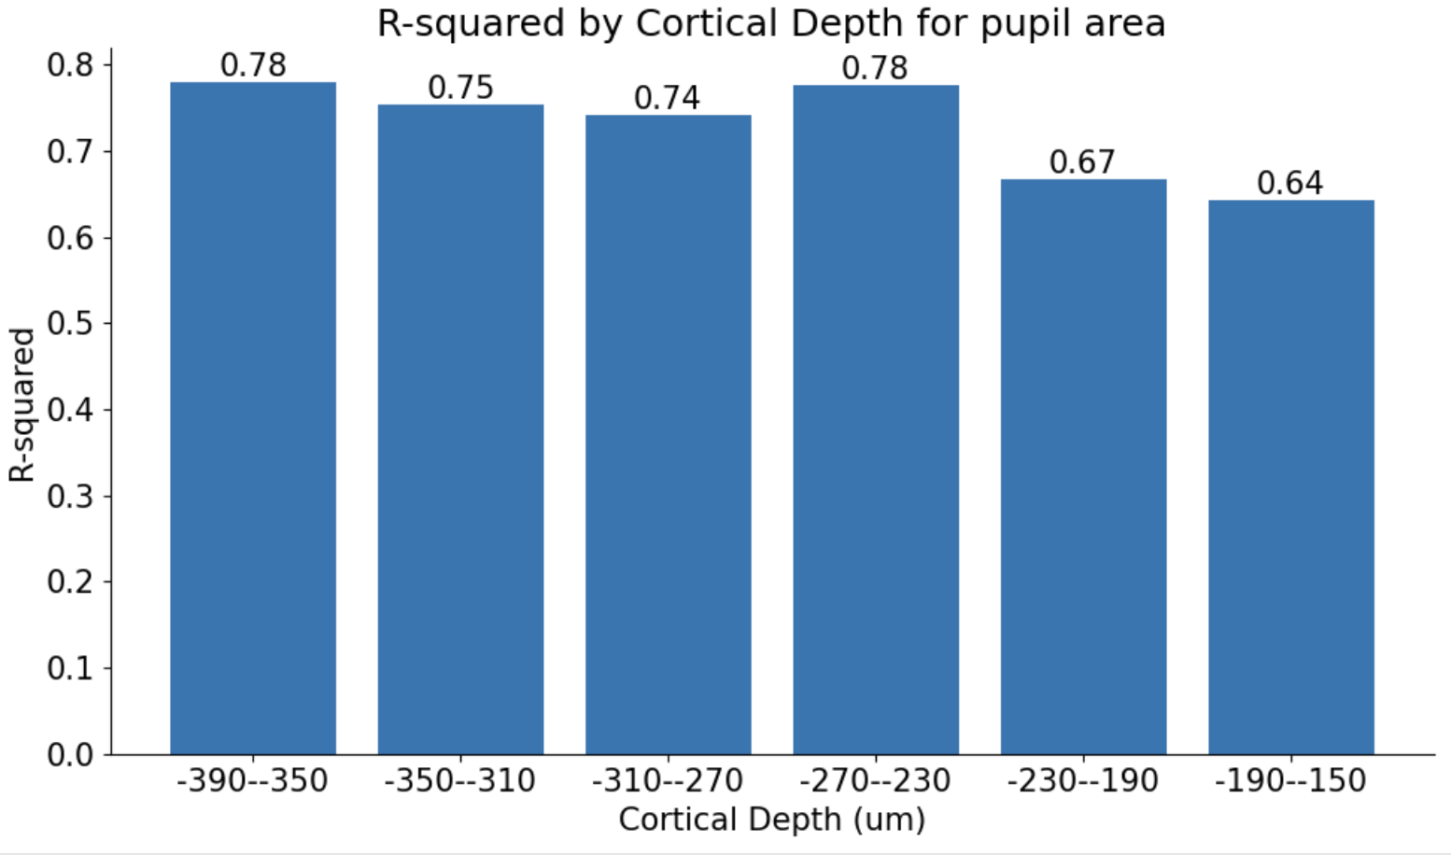
Cortical Depth Analysis for Pupil Area
Depth with highest R^2 value: -390μm to -350μm
Depth with lowest R^2 value: -190μm to -150μm

Slide 14
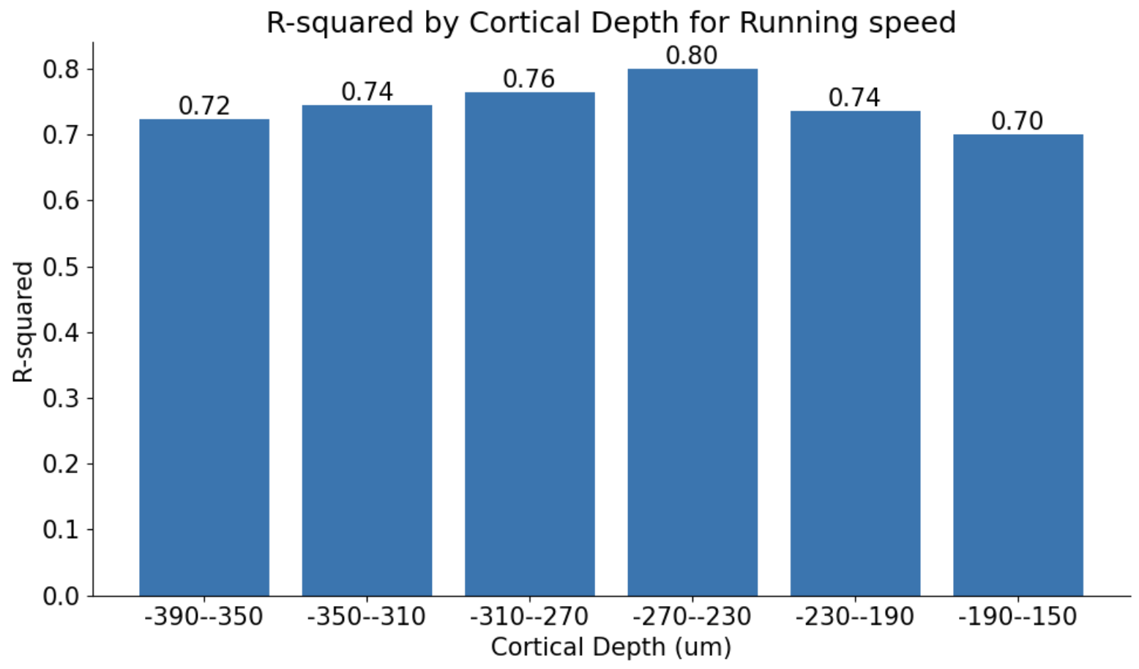
Cortical Depth Analysis for Running
Depth with highest R^2 value: -270μm to -230 μm
Depth with lowest R^2 value: -190μm to -150 μm

Slide 15
Comparative analysis
Top Performers:
For pupil area: The range -390 to -350 μm is the top performer with an R-squared value of 0.78.
For running speed: The range -270 to -230 μm is the top performer with an R-squared value of 0.80.
Worst Performers:
For both pupil area and running speed, the range -190 to -150 μm shows the lowest predictive power with R-squared values of 0.64 and 0.70, respectively.
Coμmon Depth Ranges:
The ranges -350 to -310 μm and -310 to -270 μm show relatively high R-squared values for both pupil area and running speed, indicating that these depth ranges are important for both types of spontaneous behaviors.

Slide 16
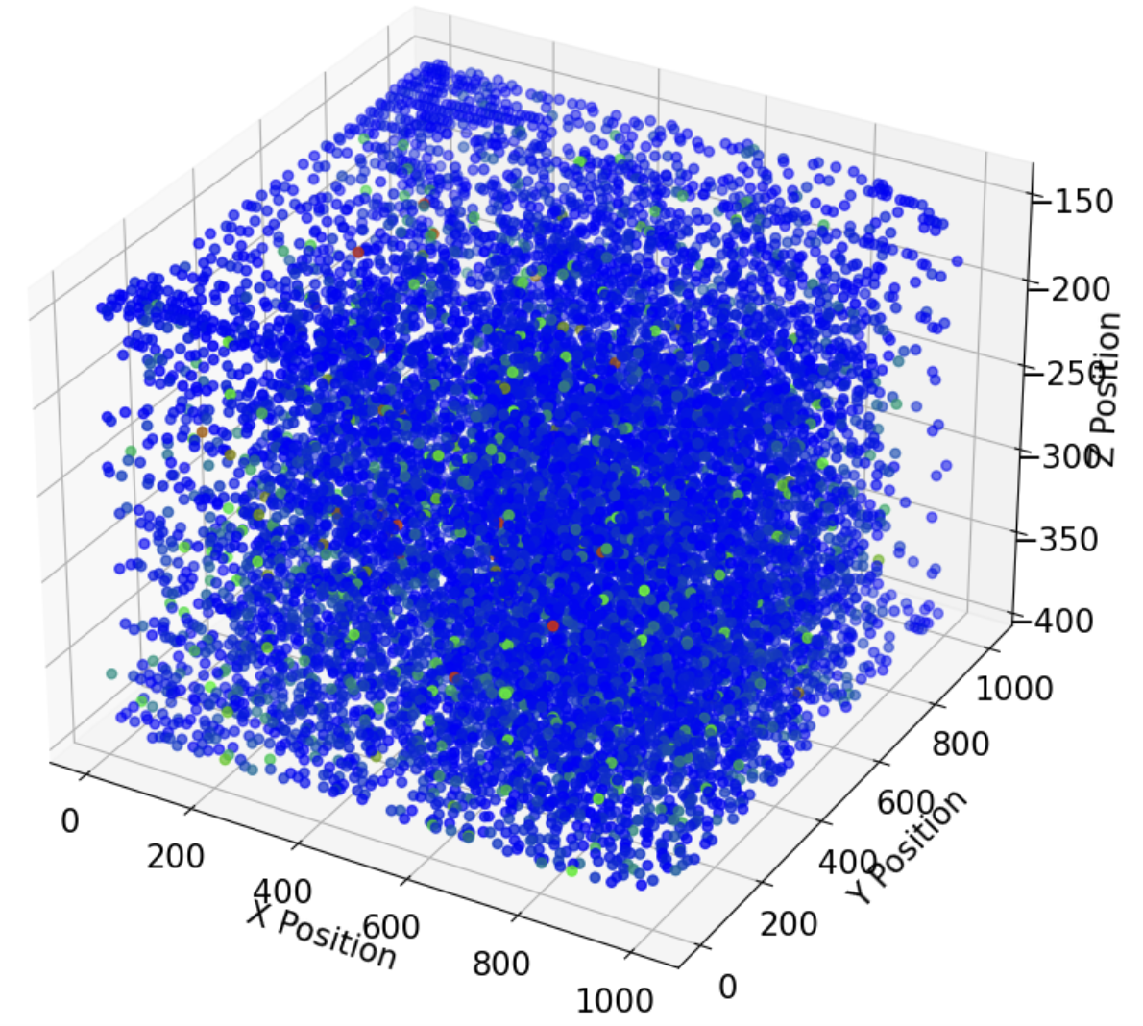
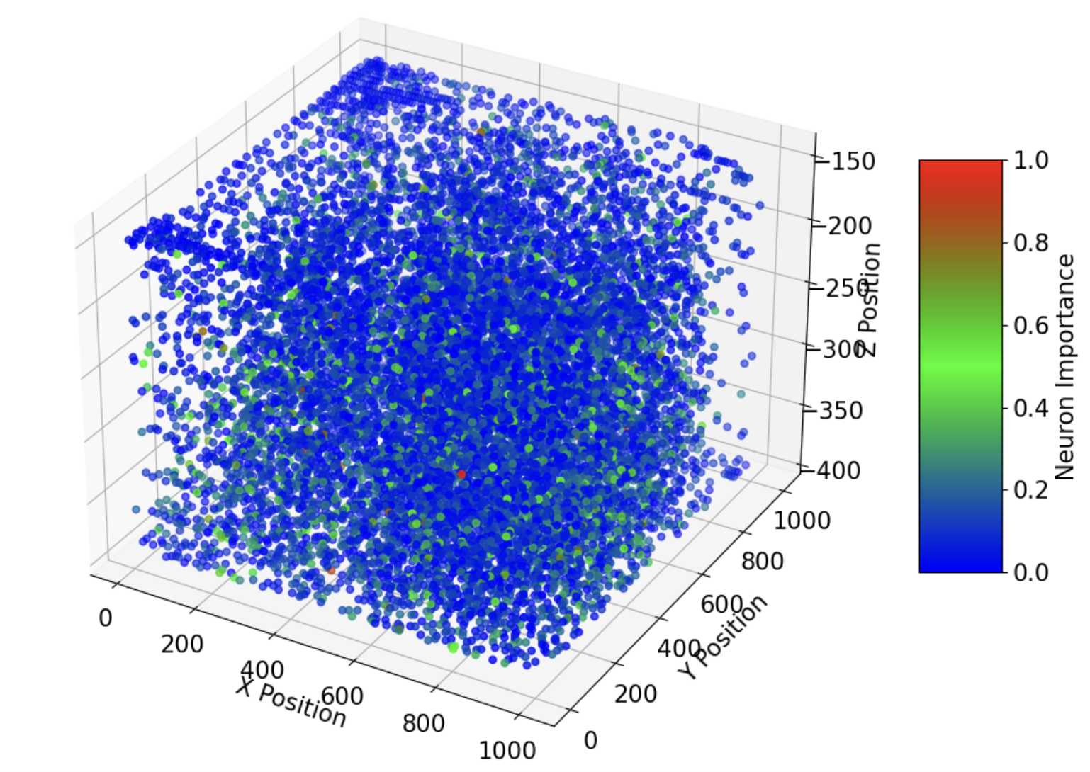
3D Visualization of Neuron Importance in Encoding Spontaneous Behaviour (Sparse Coding)
Running Speed Pupil Area

Slide 17
Conclusion
Majority of neurons show a low coefficient of encoding spontaneous behaviour
The neurons in deeper cortical layers (-390 to -350 μm) are more effective in predicting pupil area, while neurons in mid-deep layers (-270 to -230 μm) are more effective in predicting running speed.
The superficial cortical layers (-190 to -150 μm) have the lowest predictive power for both behaviors, suggesting that these neurons might be less involved in encoding pupil area changes and running speed.
Understanding these depth-dependent variations in predictive power can provide insights into the functional organization of the visual cortex and its role in processing different spontaneous behaviors.

Slide 18
Further Studies
Deepening Understanding of Cortical Depth Involvement:
Investigate specific neuronal populations
Refine depth segmentation
Correlate depth-specific findings with anatomical and functional markers

Slide 19
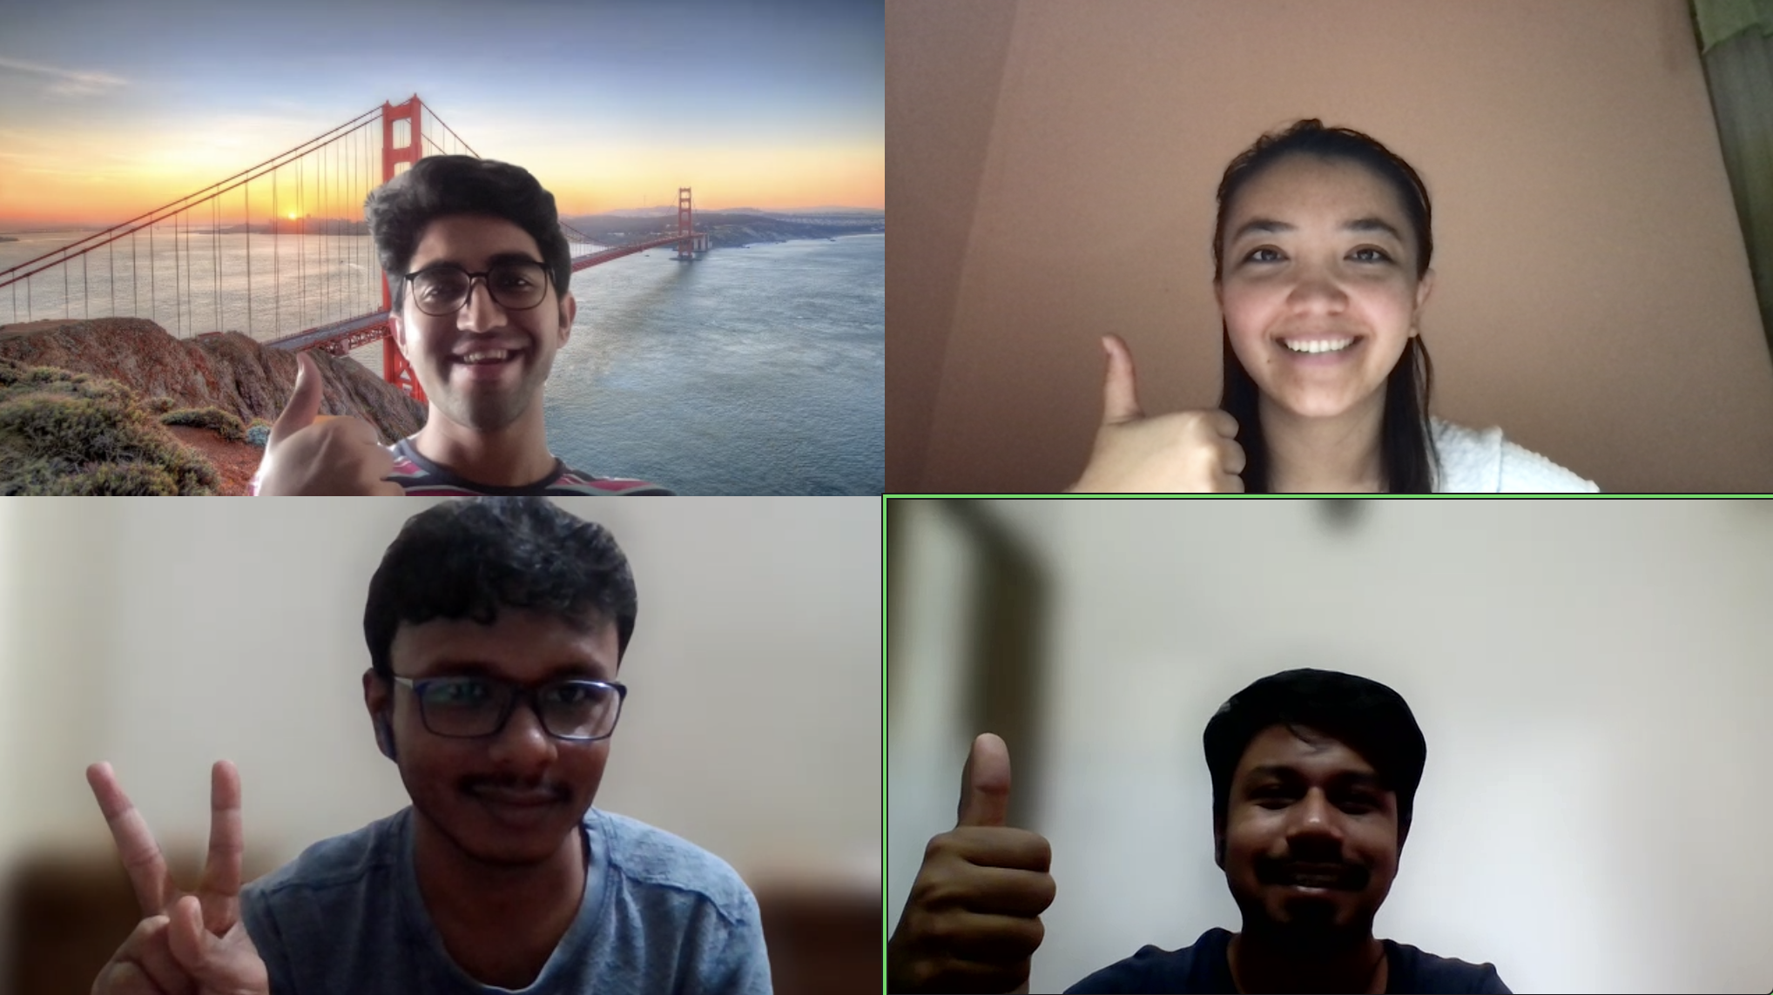
ধন্যবাদ!
धन्यवाद!
Rahmat!
متشکرم!
Thank You!

